Slide 1


Agriculture
Conservation
Wildlife
Reclamation Restoration
Beautification
Renewable Energy

Slide 2
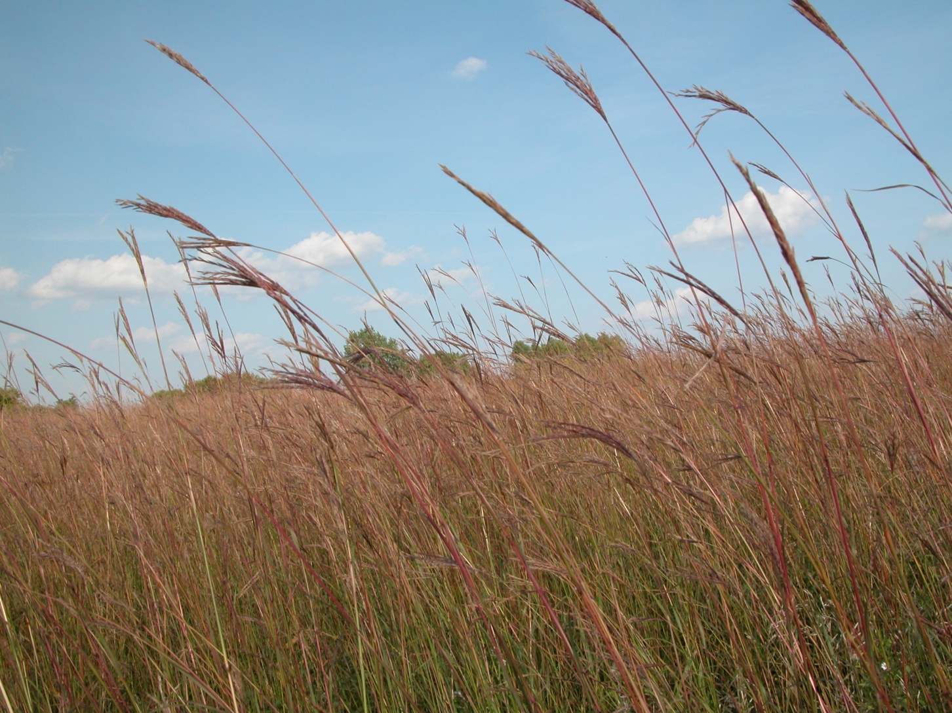
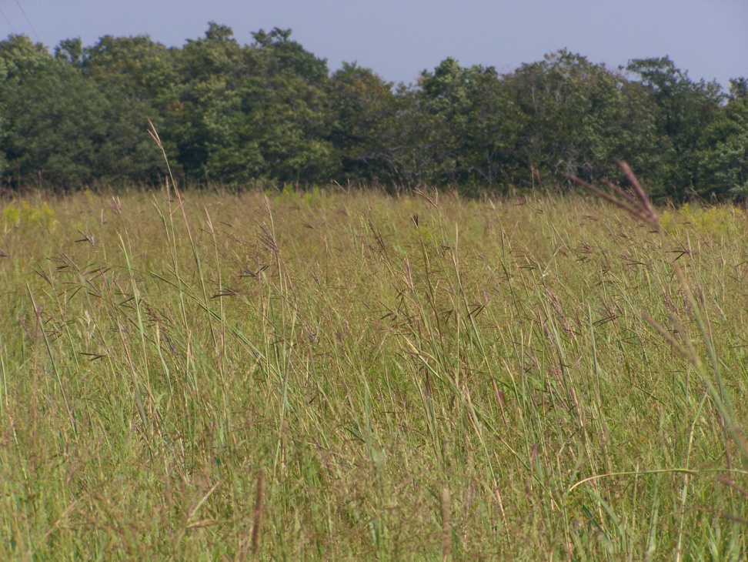
BIG BLUESTEM

Slide 3
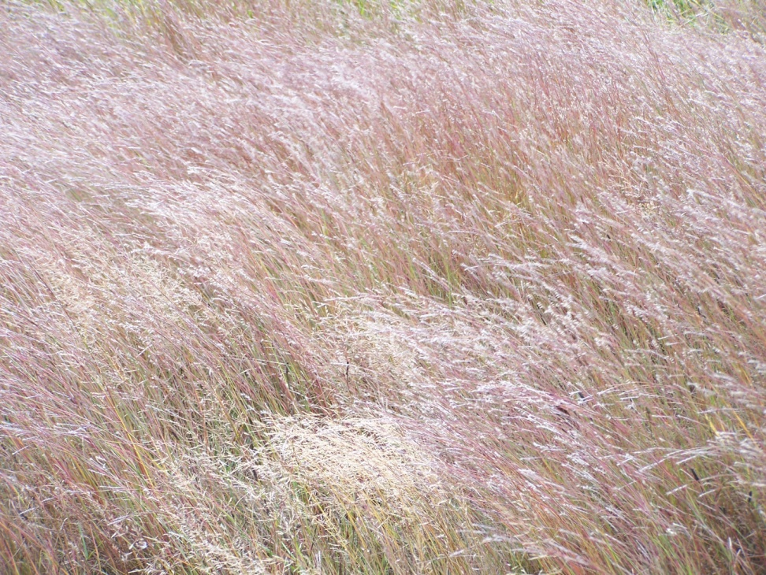
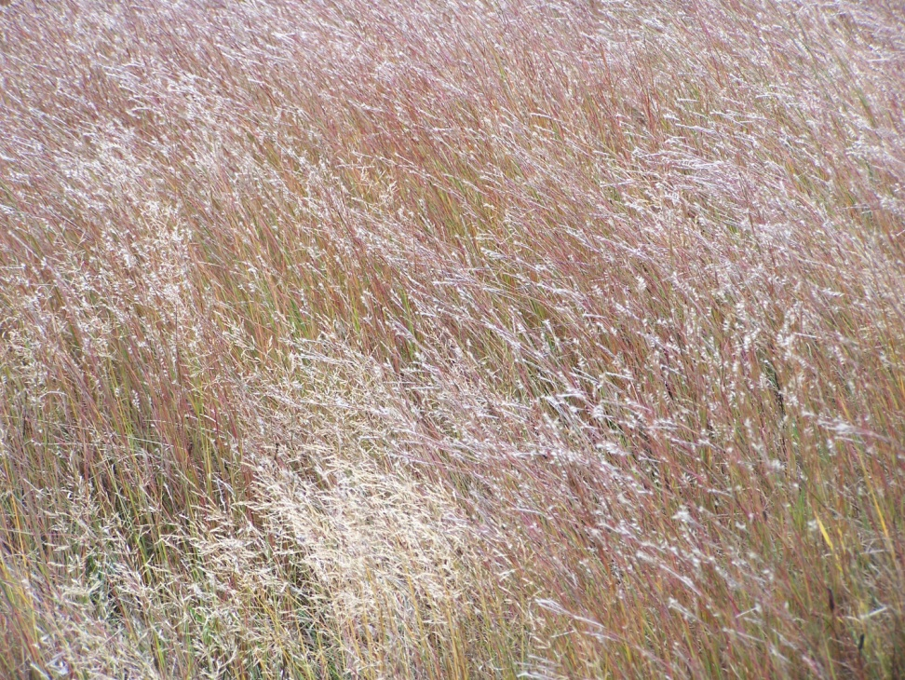
LITTLE BLUESTEM

Slide 4
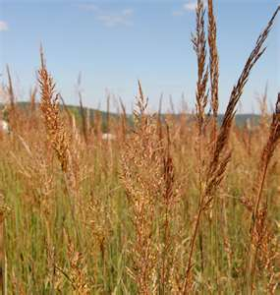
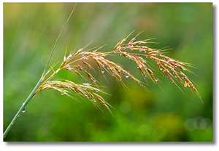
INDIAN GRASS

Slide 5
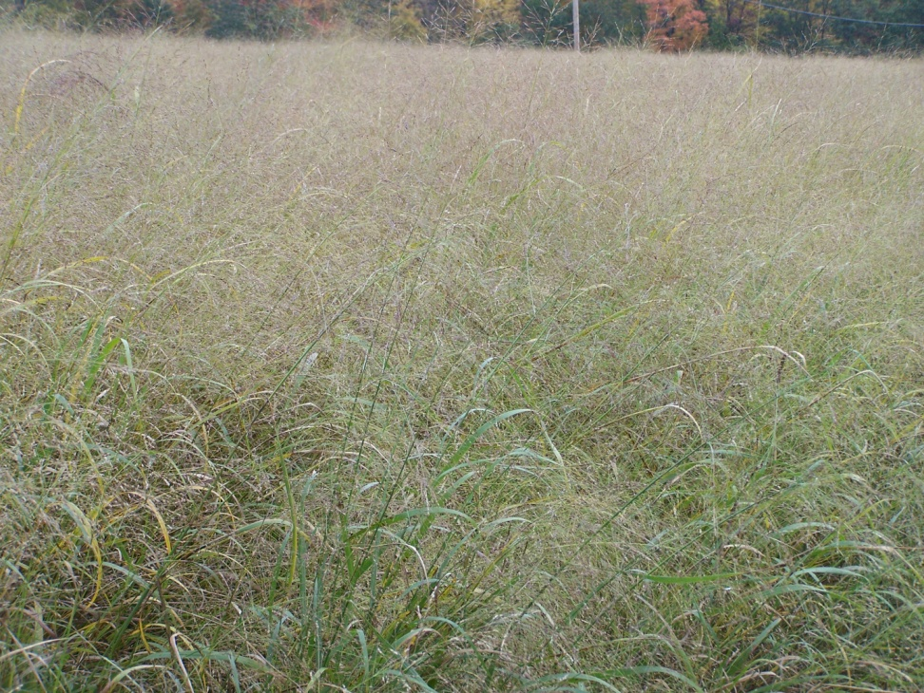
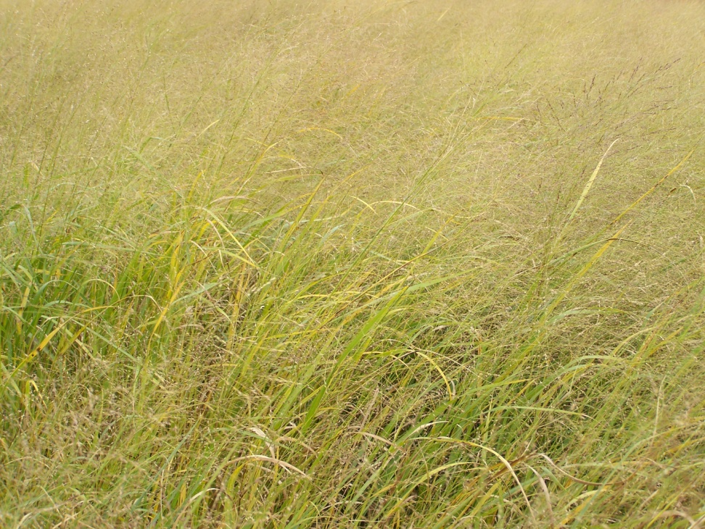
SWITCHGRASS

Slide 6
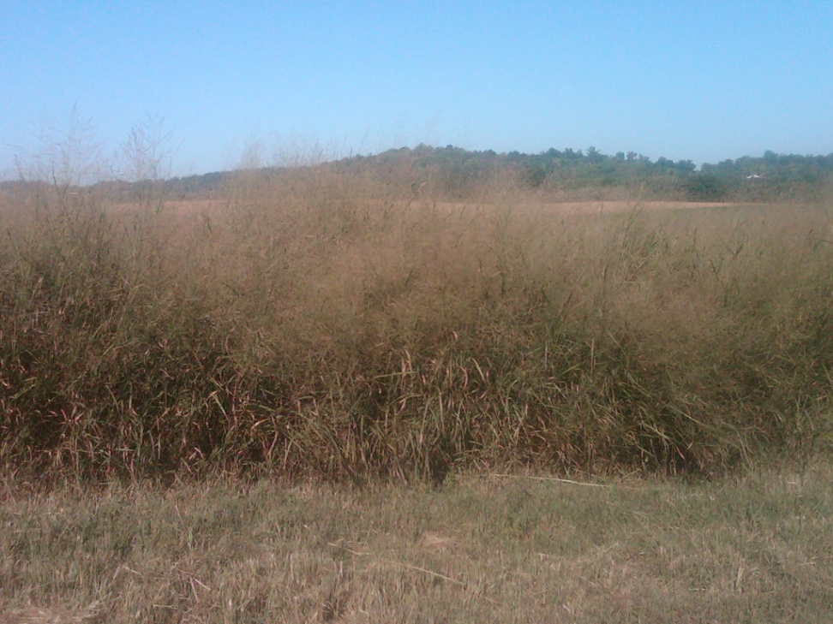
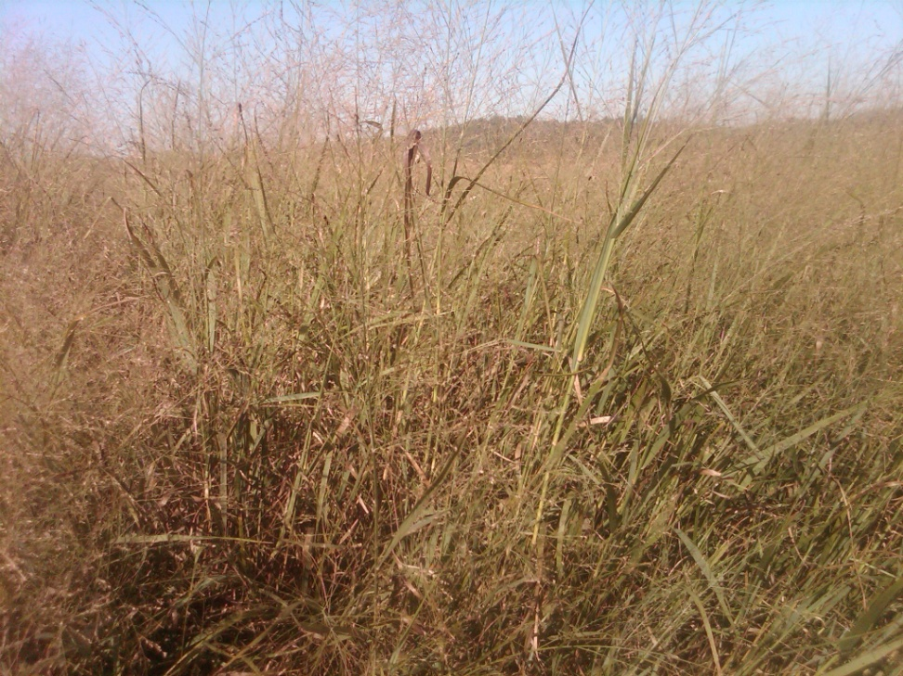
SWICTHGRASS

Slide 7
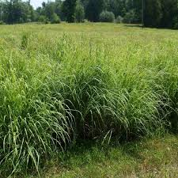
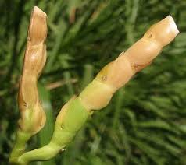
Eastern Grama Grass

Slide 8
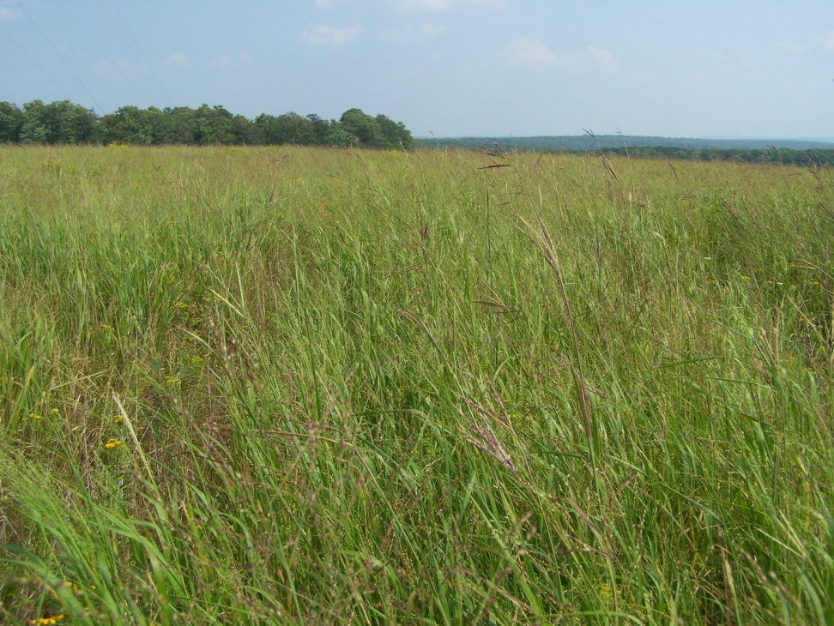
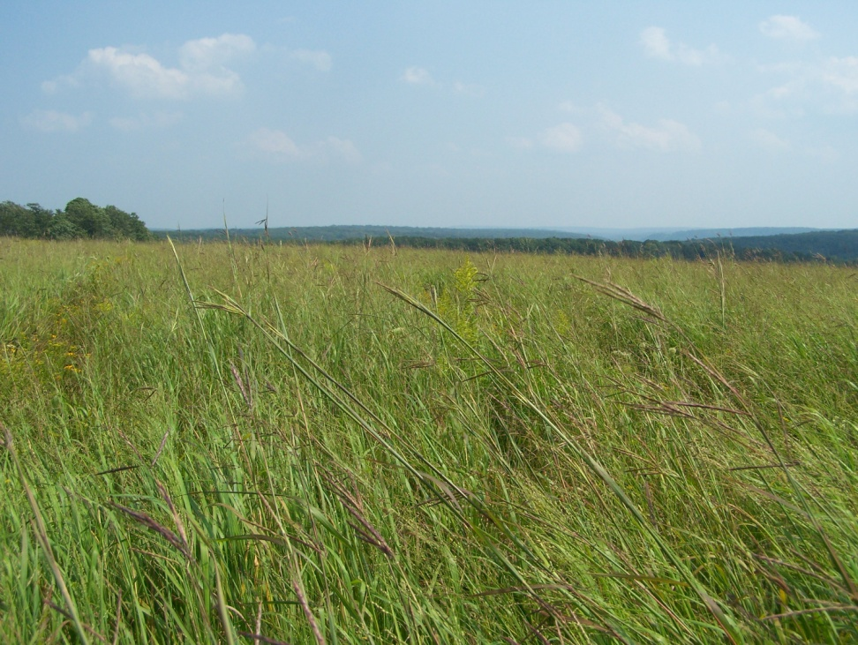
NATIVE GRASS MIX
Native Grass Mix at 4 years
Native Grass Mix at 4 years

Slide 9
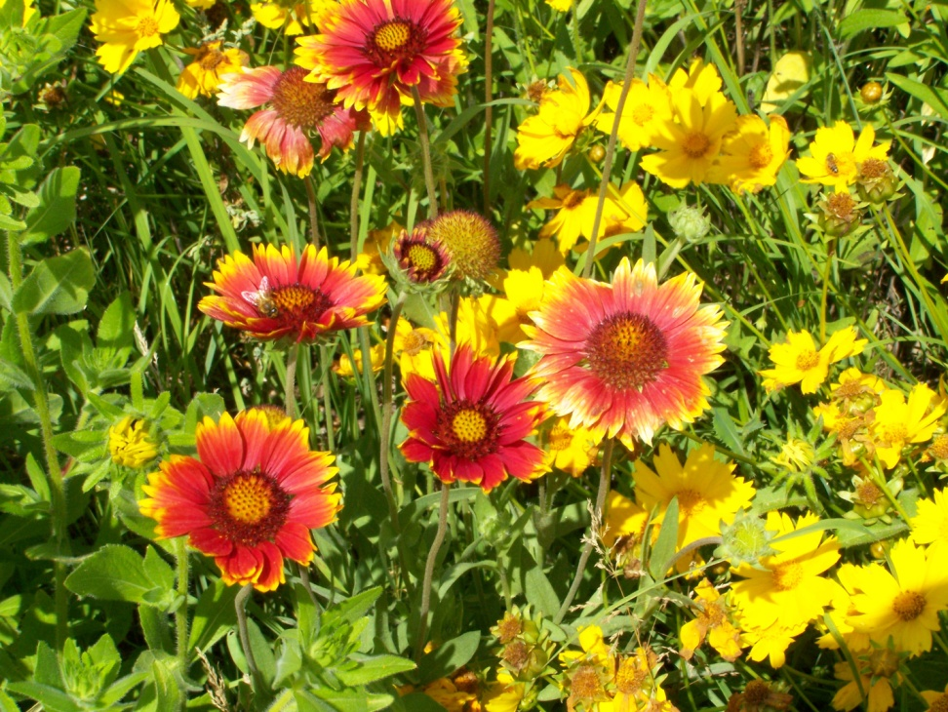
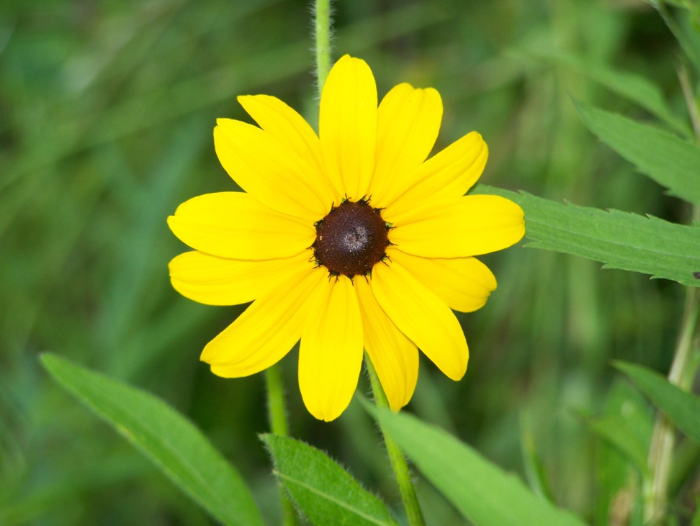
WILDFLOWERS
Blanket Flower
Black-Eyed-Susan

Slide 10
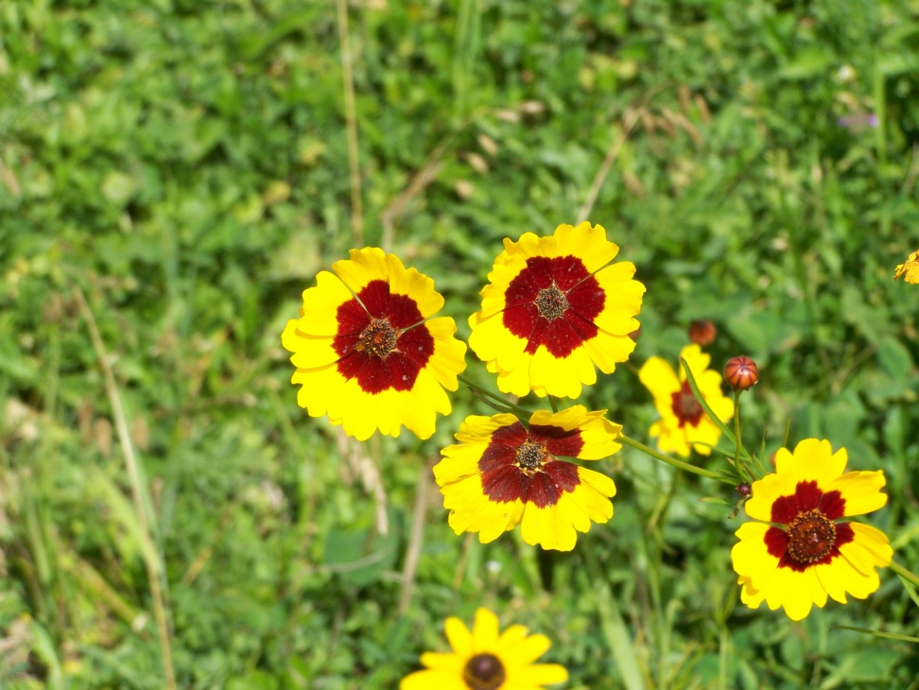
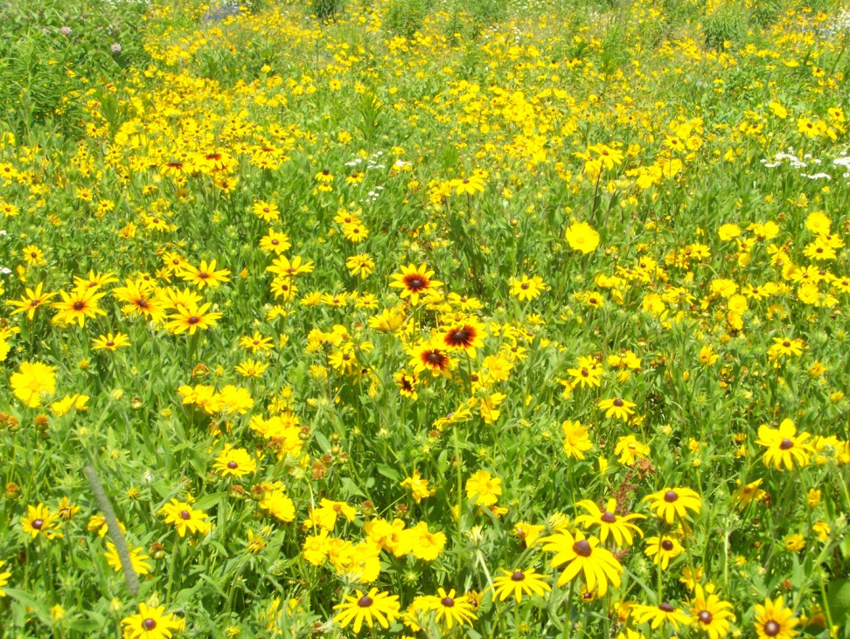
WILDFLOWERS
Cosmos
Coreopsis, Blanket Flower, Black-Eyed-Susan

Slide 11
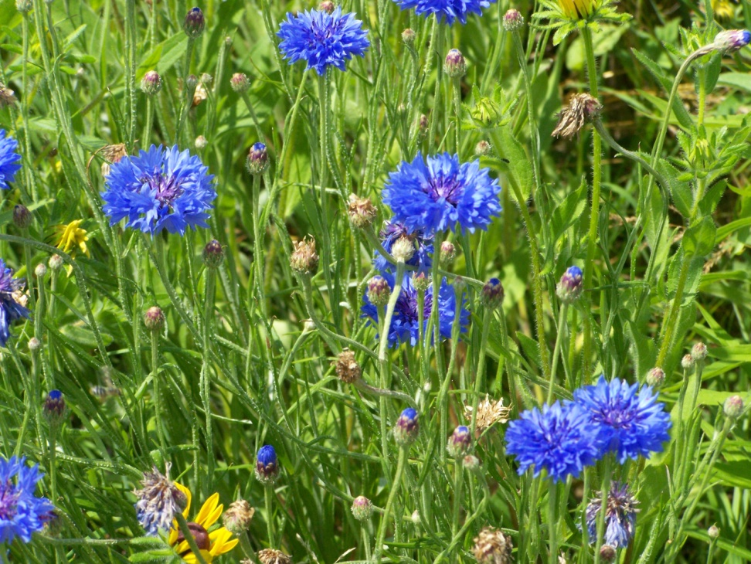
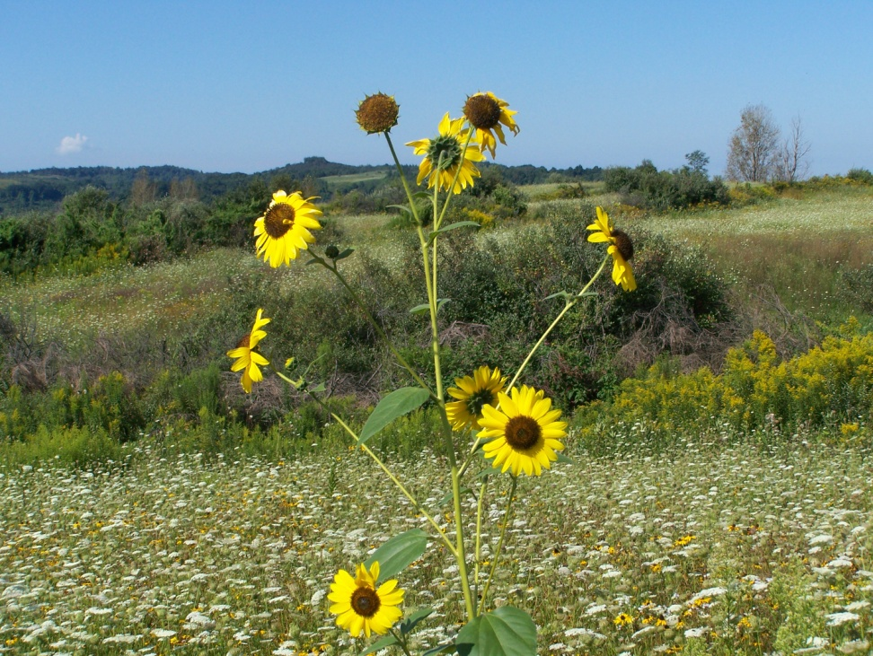
WILDFLOWERS
Cornflower
Sunflower

Slide 12
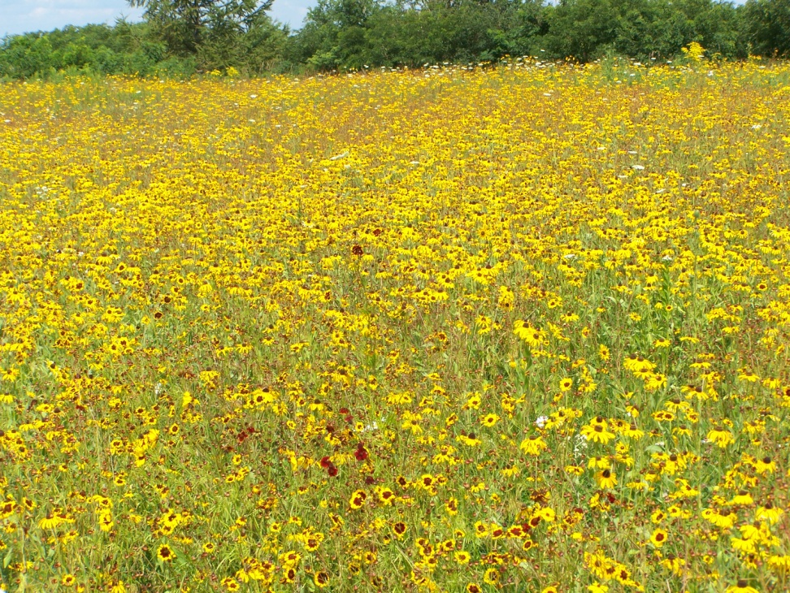
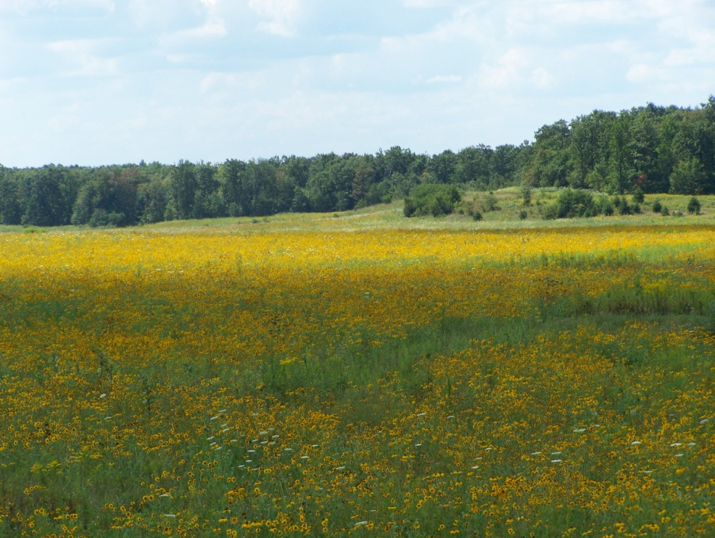
WILDFLOWERS
Wildflower Mix
Wildflower Mix

Slide 13
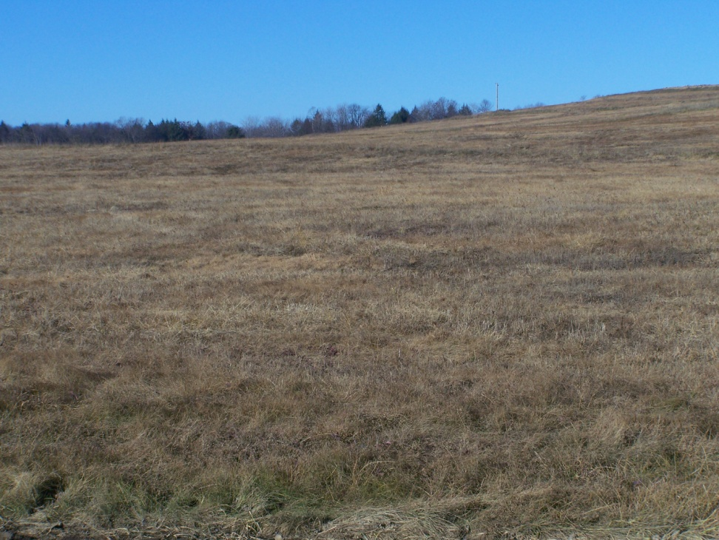
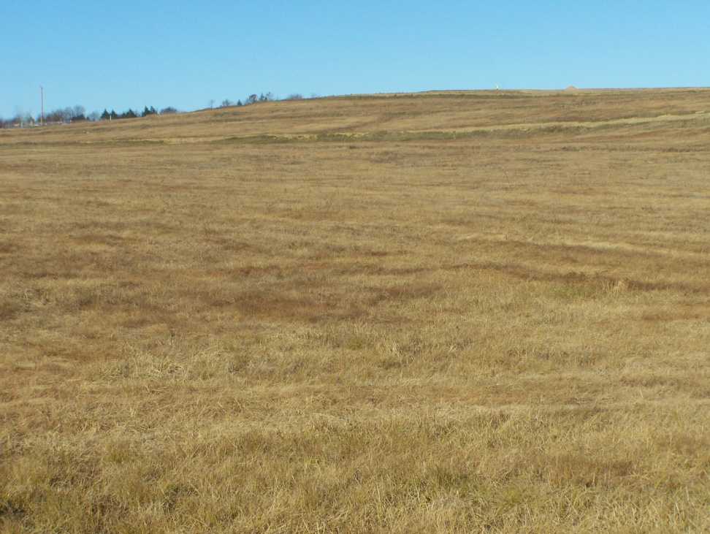
SPRAYED FIELDS
After a fall spraying
After a follow up spraying in the spring

Slide 14
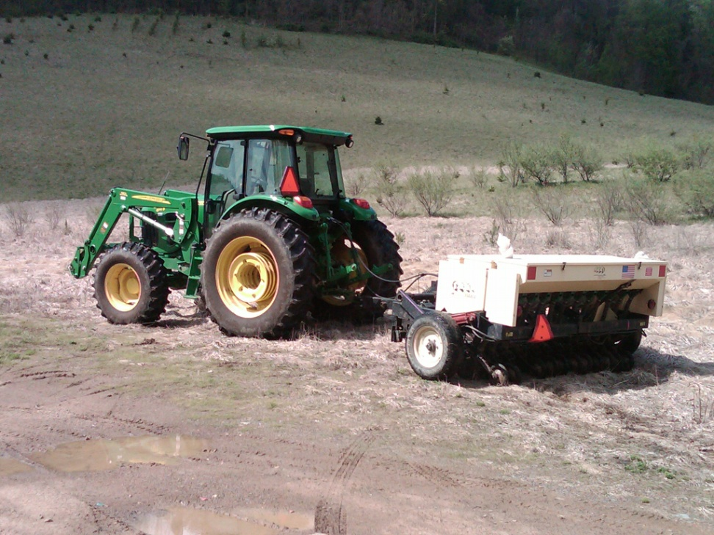
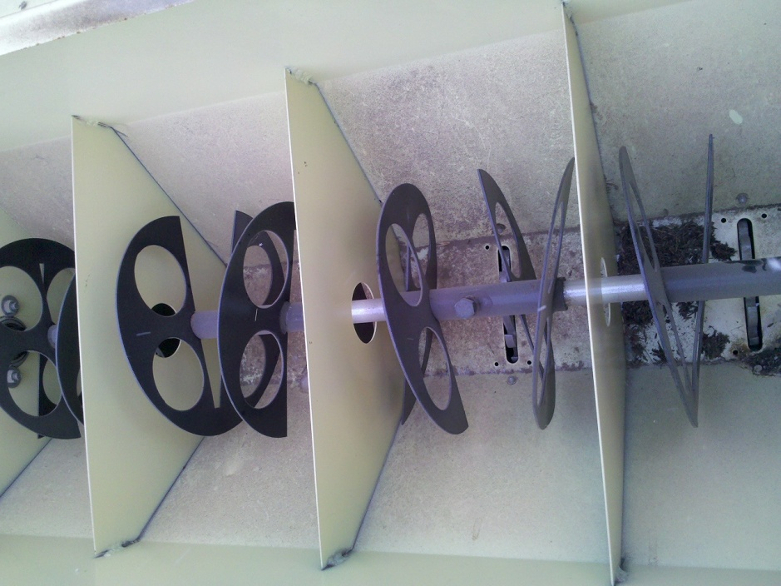
Native Grass seed box
Tractor and a No-Till- Drill , Looking inside the Native grass seed box

Slide 15
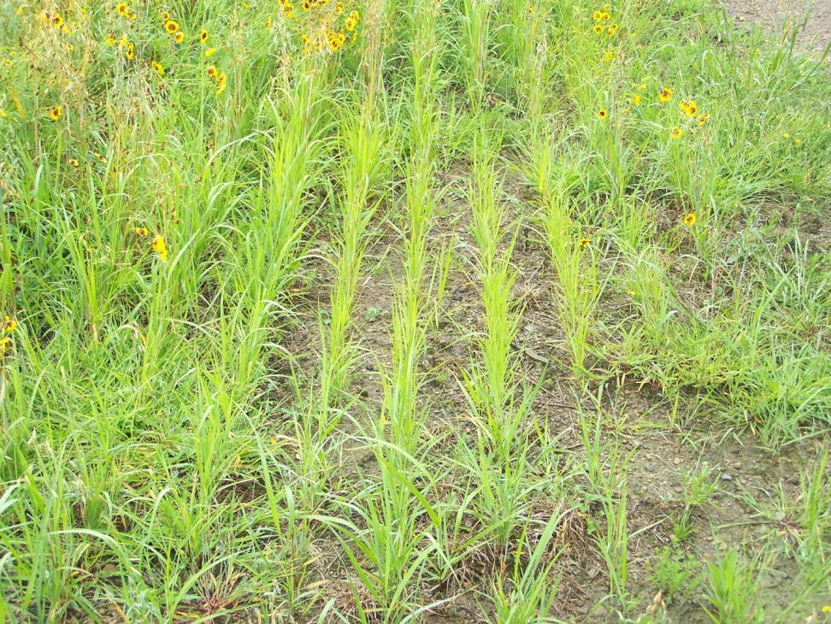
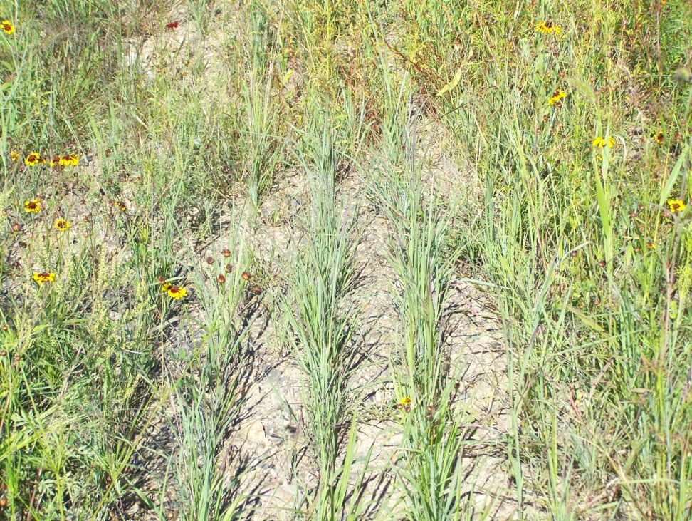
Native Grass planting 2 months after planting date!

Slide 16
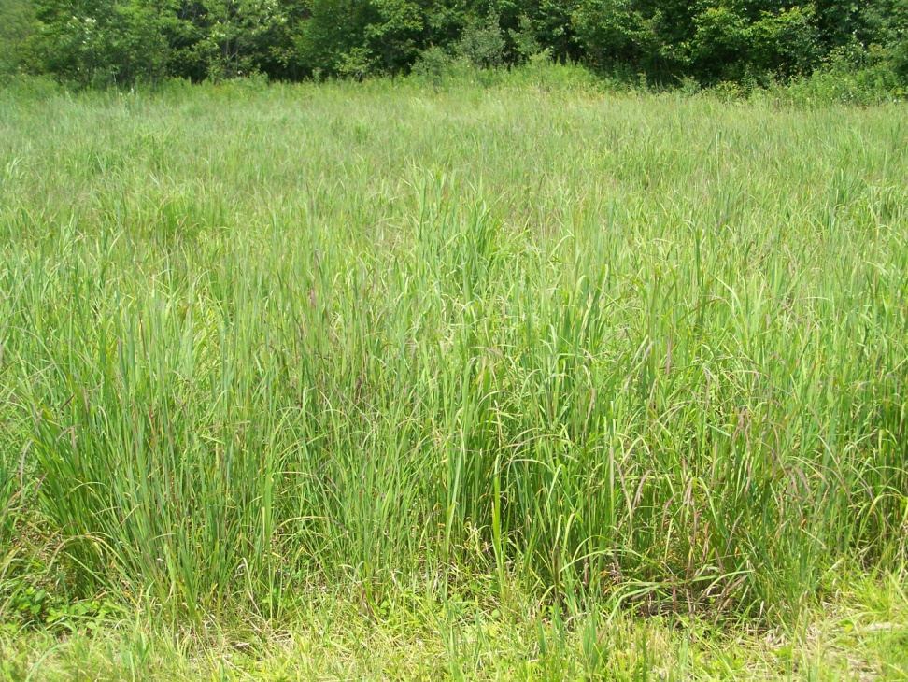
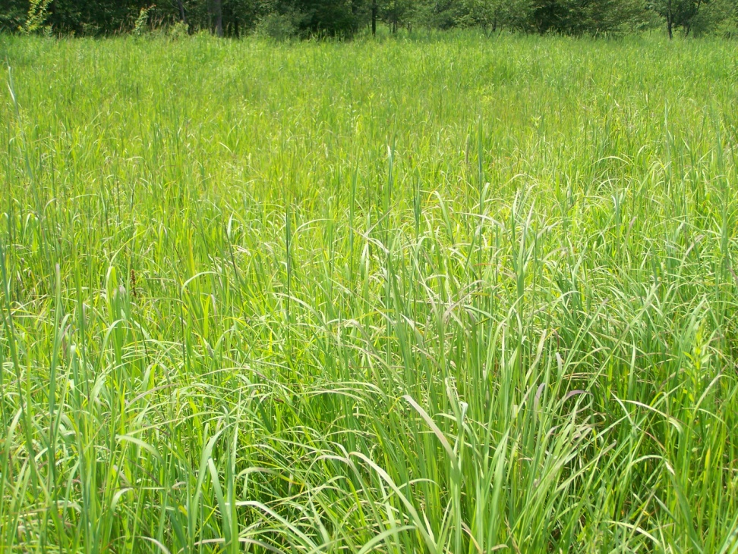
2nd year after planting

Slide 17
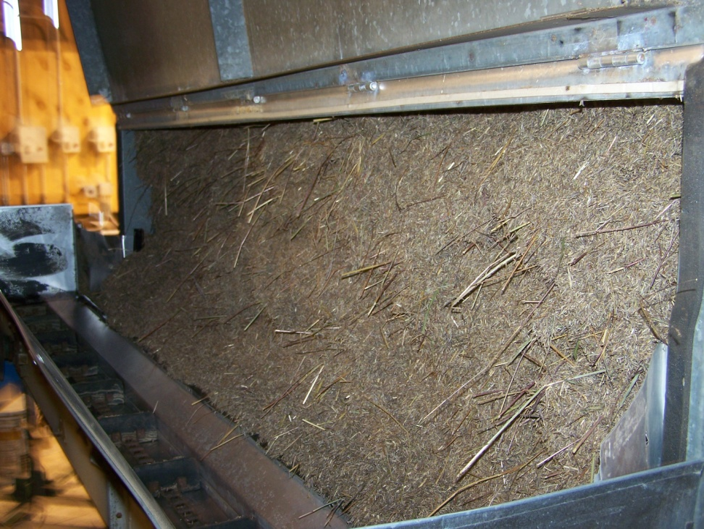
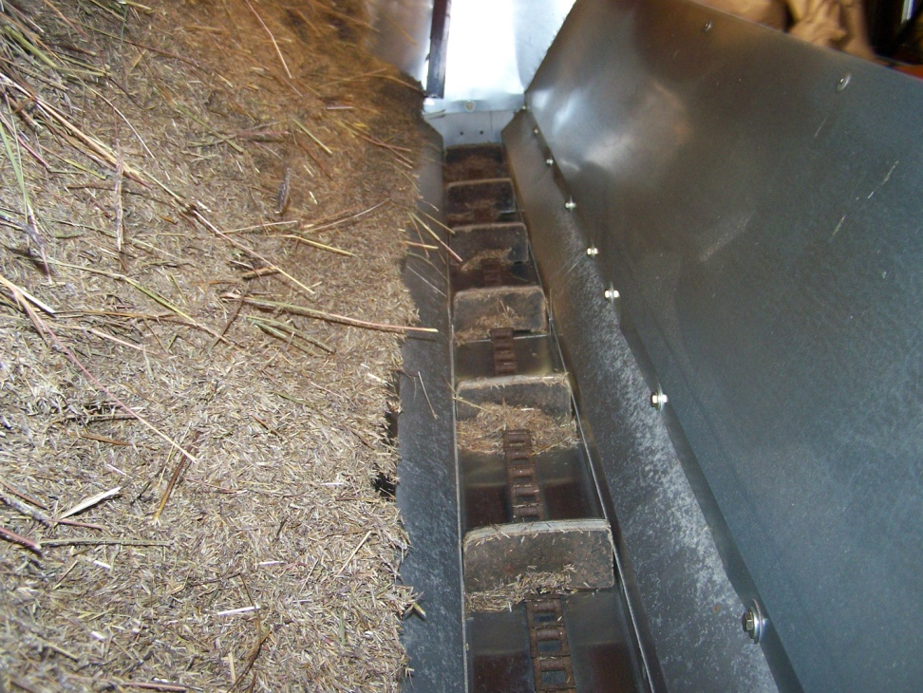
SEED CLEANING

Slide 18
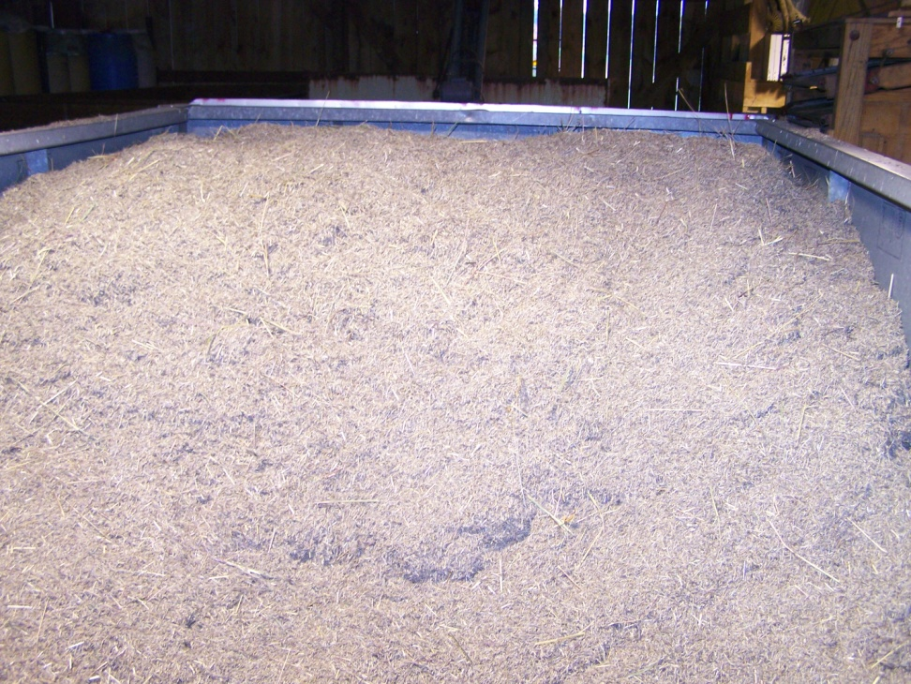
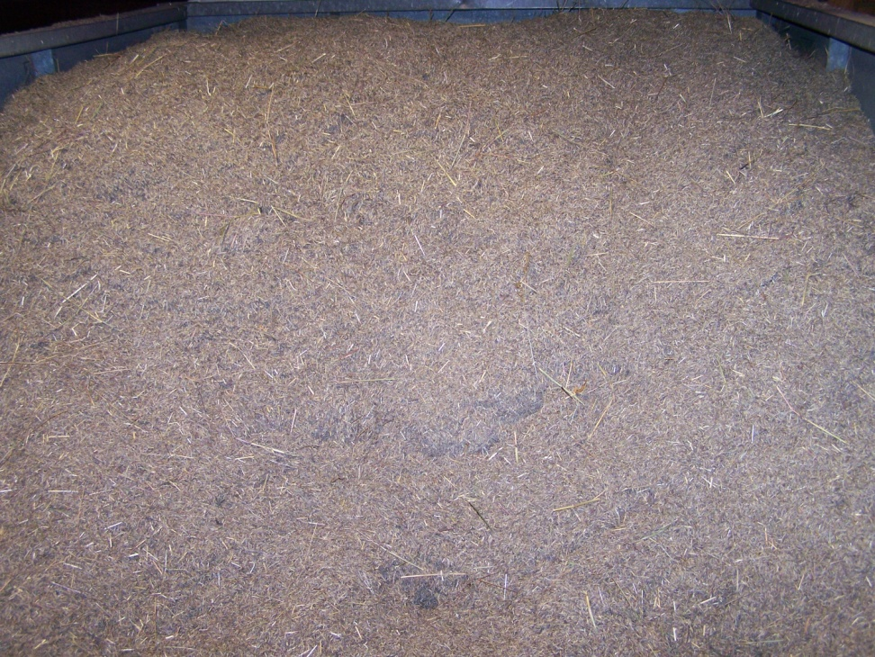
SEED CLEANING

Slide 19
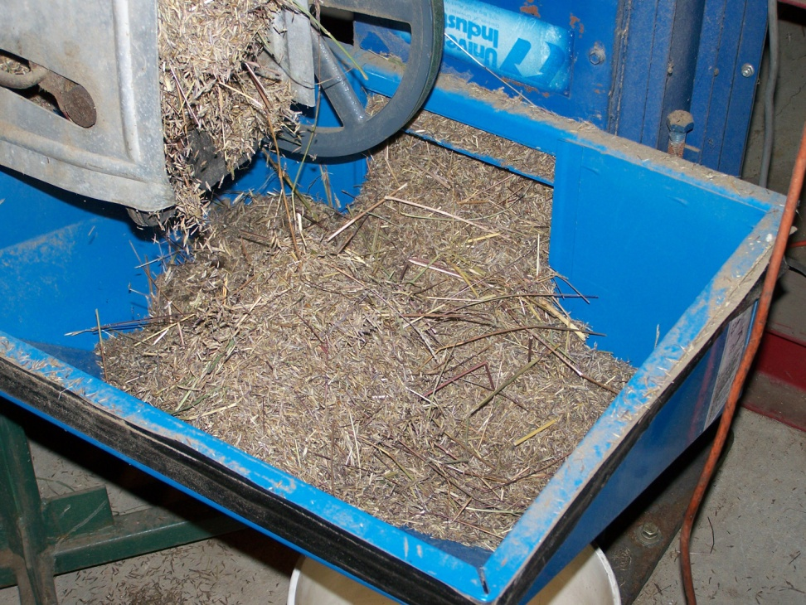
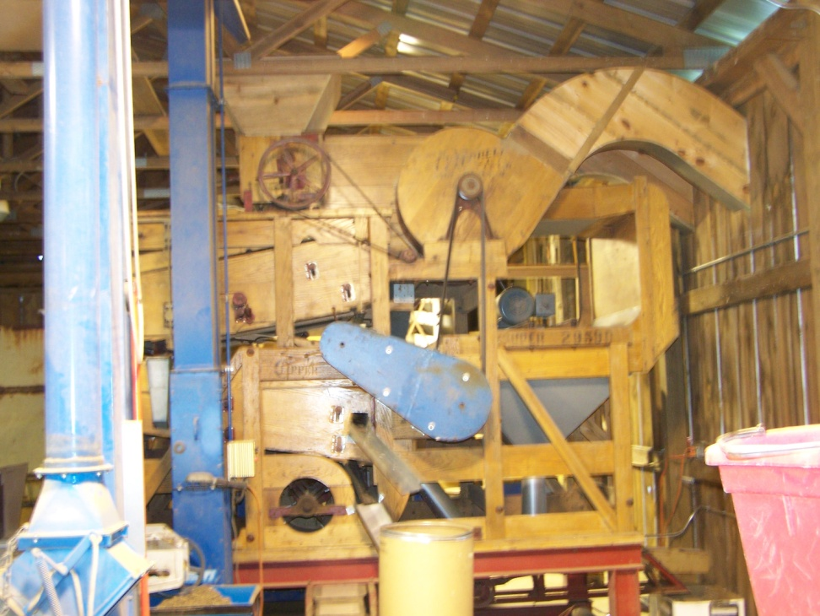
SEED CLEANER

Slide 20
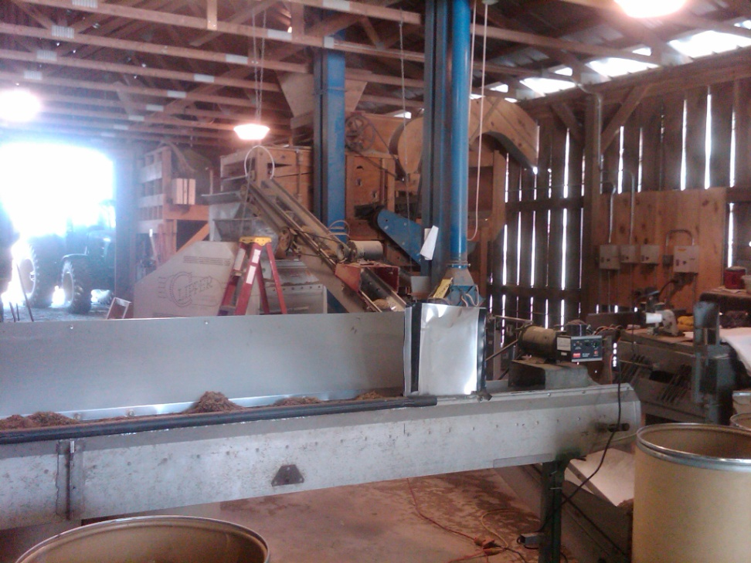
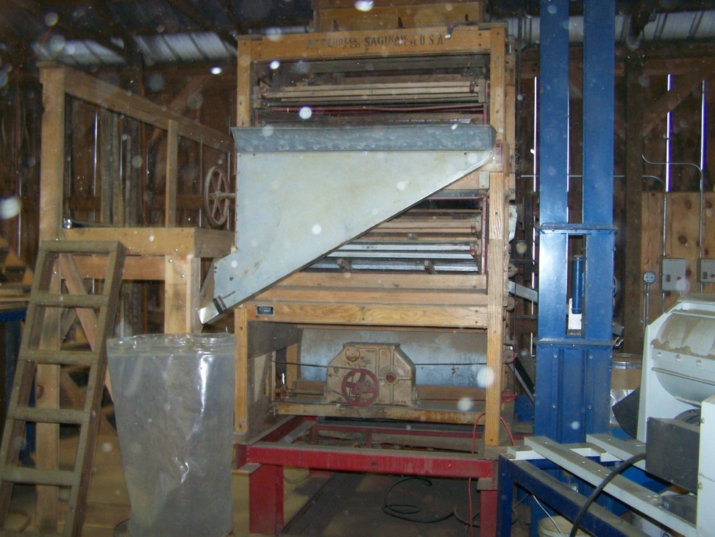
SEED CLEANER
Seed Cleaner set up
Seed Cleaner

Slide 21
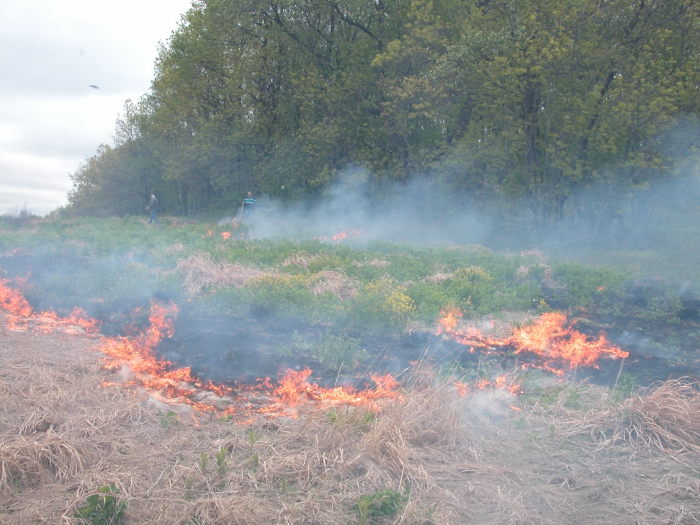
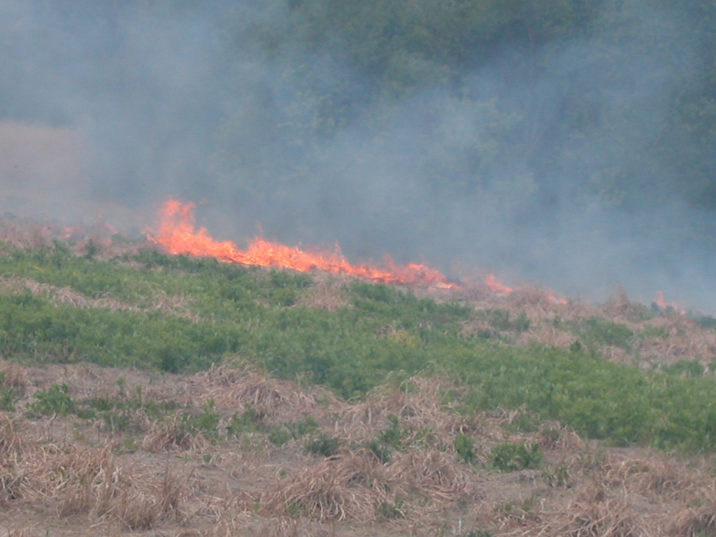
CONTROLLED BURN
About 2 minutes into the fire
Starting to move a little faster

Slide 22
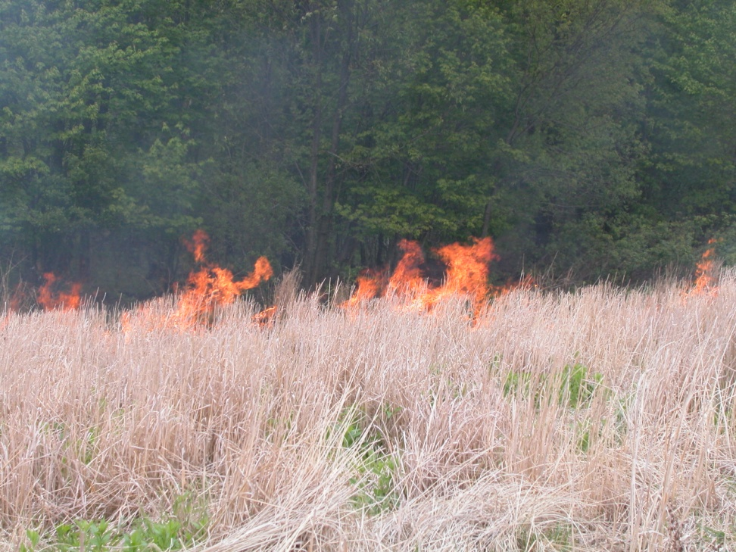
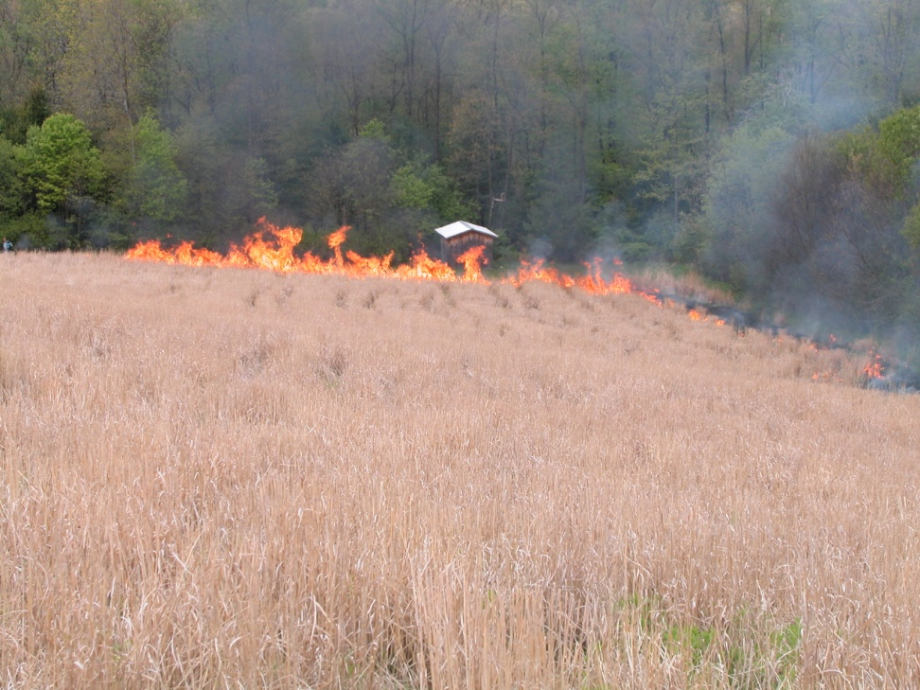
CONTROLLED BURN
Starting the main fire
Main fire

Slide 23
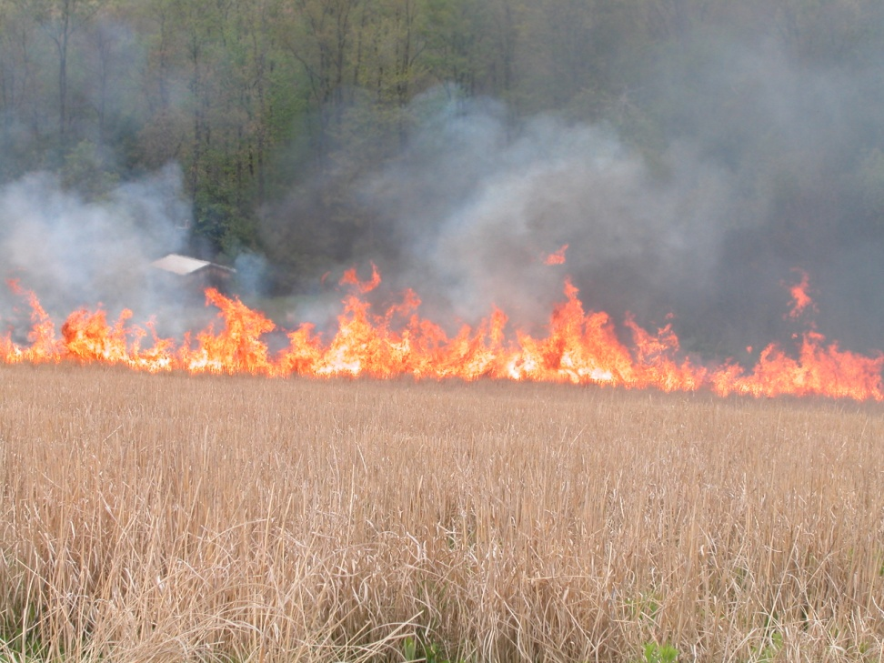
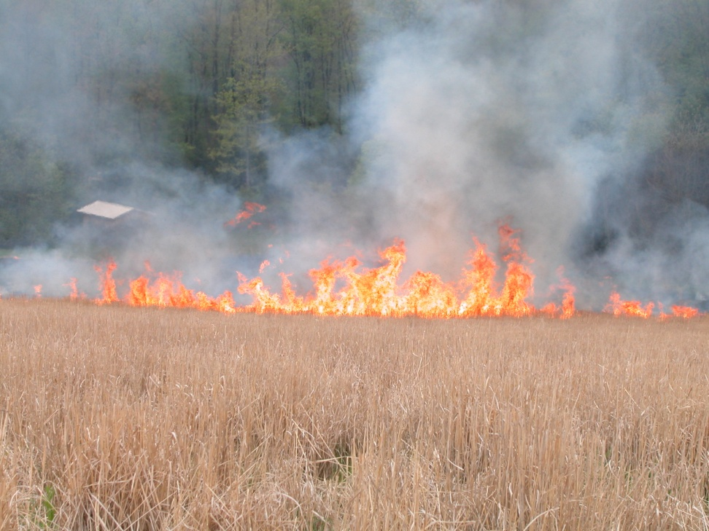
CONTROLLED BURN
The fire is moving up the hill
Starting to move fast and hotter

Slide 24
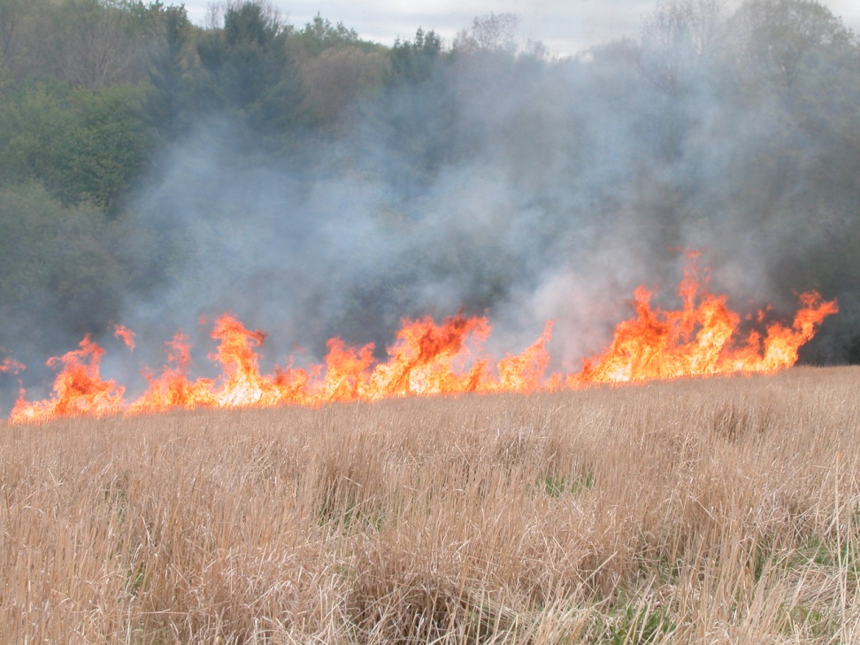
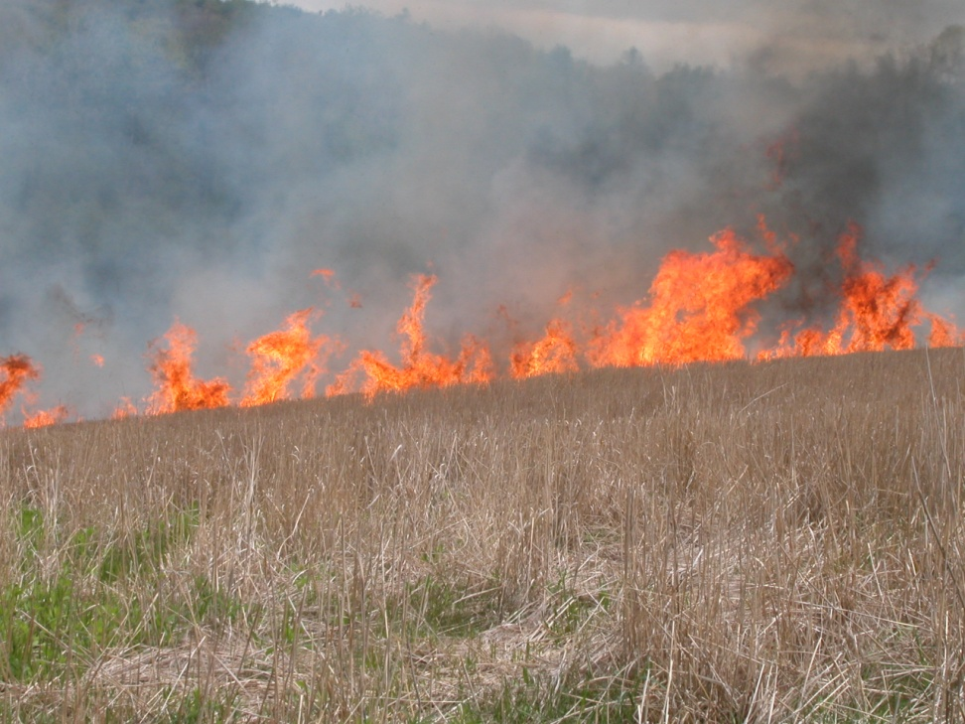
CONTROLLED BURN
Now its really moving fast
Fire is on the move

Slide 25
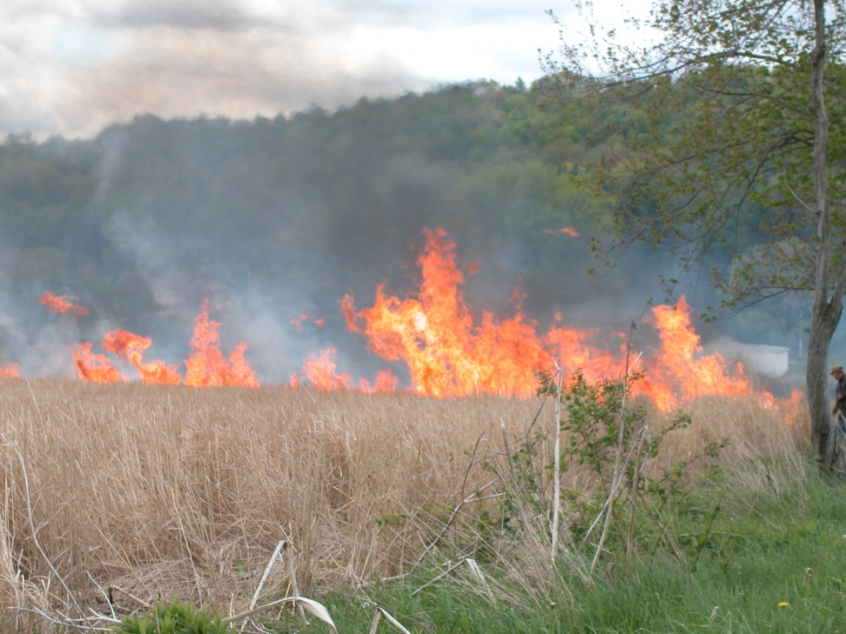
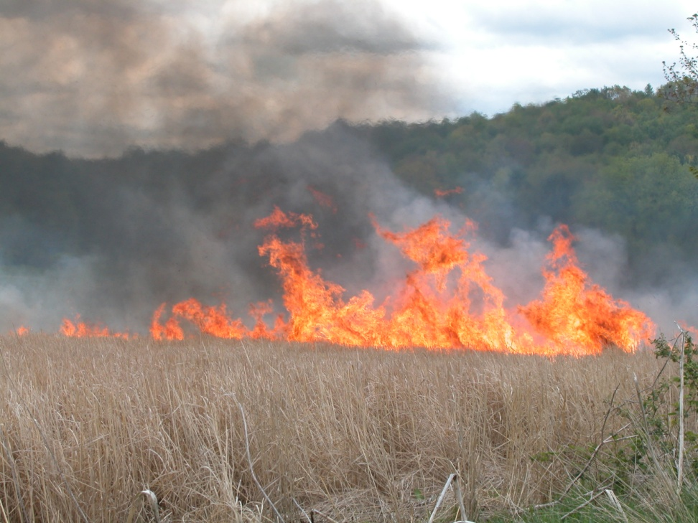
CONTROLLED BURN
About 5 minutes into the burn
About 7 minutes into the burn

Slide 26
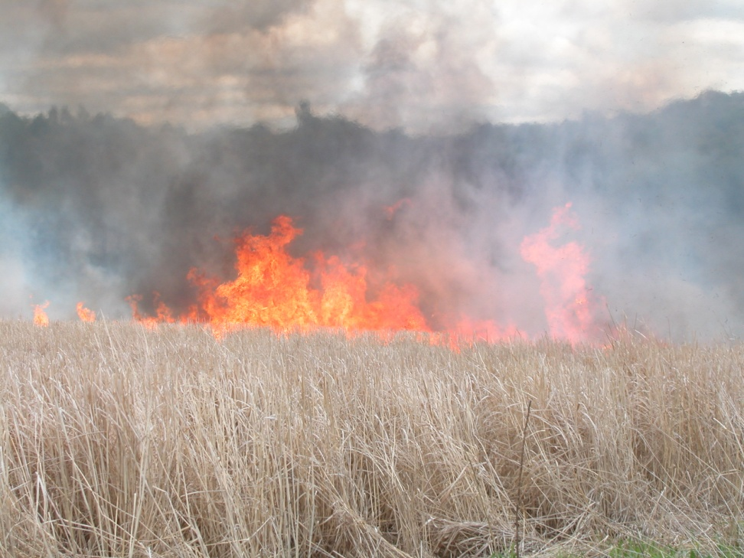
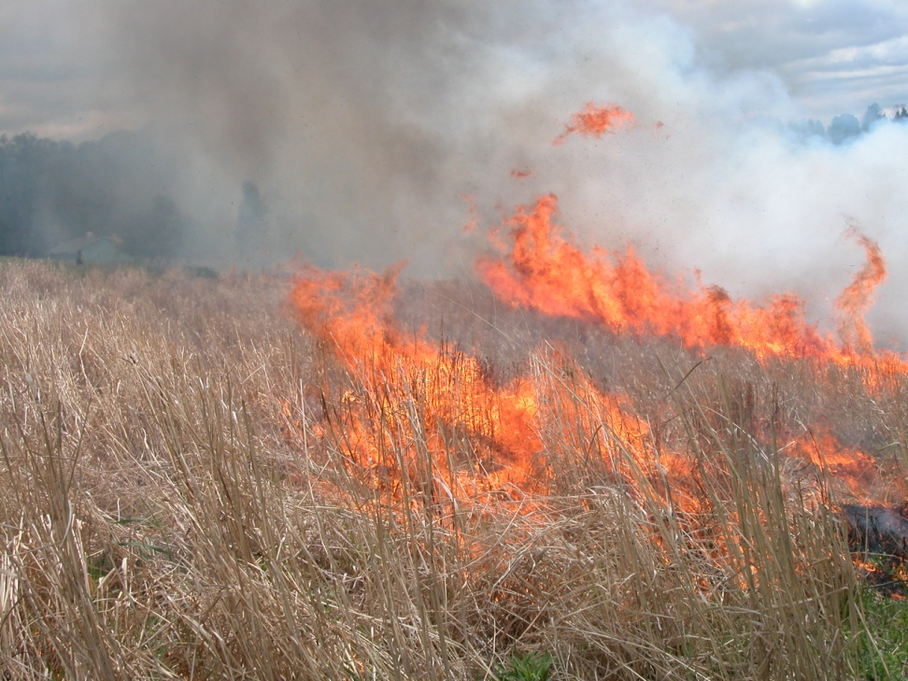
CONTROLLED BURN
Now its really on the move

Slide 27


CONTROLLED BURN
Fire is well on the move at this point

Slide 28


CONTROLLED BURN
Field is almost out

Slide 29


CONTROLLED BURN
Fire is out, and only took 20 minutes
This field was 15 acres.

Slide 30
Any Question?? Thank you and Have a great Day!!

